Slide 1
Shading & Lightning

Slide 2
Shading languages
OpenGL
GLSL
ARB assembly language
DirectX
HLSL
DirectX Shader Assembly Language

Slide 3
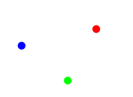
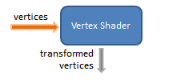
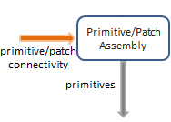
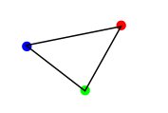


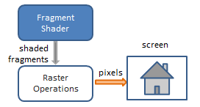
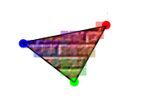
Klassische Renderpipeline

Slide 4
GLSL-Basics
#version 440
in vec4 vPosition;
void main()
{
}

Slide 5
GLSL-Datentypen
Standarddatentypen:
float, double, bool, int, uint
Geometrische Datentypen:
Texturen
sampler1D, sampler2D, sampler3D…
dvec4 | dmat4
bvec4
ivec4
uvec4
vec4 | mat4
vec3 | mat3
vec2 | mat2
vec1 | mat1

Slide 6
Rechnen mit geometrische Datentypen
vec4 eingabeVektor = vec4(1, 0.5, 0.2, 2);
eingabeVektor.x = 2;
eingabeVektor.xyz = vec3(1, 2, 3);
eingabeVektor.rgb = vec3(42);
mat4 eingabeMatrix = ...
vec4 ergebnis = eingabeMatrix * eingabeVektor;
ergebnis = ergebnis * 2.0;

Slide 7
GLSL-Basics
#version 440
in vec4 vPosition;
uniform mat4 modelViewProjectionMatrix;
out vec4 texCoord;
void main()
{
gl_Position = gxl3d_ModelViewProjectionMatrix * gxl3d_Position;
vec4 temp = vec4(0);
texCoord = temp;
}

Slide 8
Vertexshader
#version 440
// Inputs
in vec4 gxl3d_Position;
// Const inputs
uniform mat4 gxl3d_ModelViewProjectionMatrix;
void main()
{
gl_Position = gxl3d_ModelViewProjectionMatrix * gxl3d_Position;
}

Slide 9
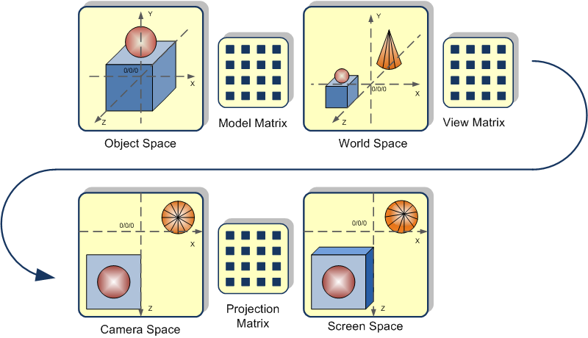
Spaces

Slide 10
Fragmentshader
#version 440
// Outputs
out vec4 Out_Color;
void main()
{
Out_Color = vec4(0.5);
}

Slide 11
Texturen - Vertexshader
[...]
// Inputs
in vec4 gxl3d_TexCoord0;
// Outputs
out vec2 texCoord;
[...]
void main()
{
gl_Position = gxl3d_ModelViewProjectionMatrix * gxl3d_Position;
texCoord = gxl3d_TexCoord0;
}

Slide 12
Texturen - Fragmentshader
[...]
// Inputs
in vec2 texCoord;
// Const inputs
uniform sampler2D tex0;
[...]
void main()
{
Out_Color = texture(tex0, texCoord);
}

Slide 13
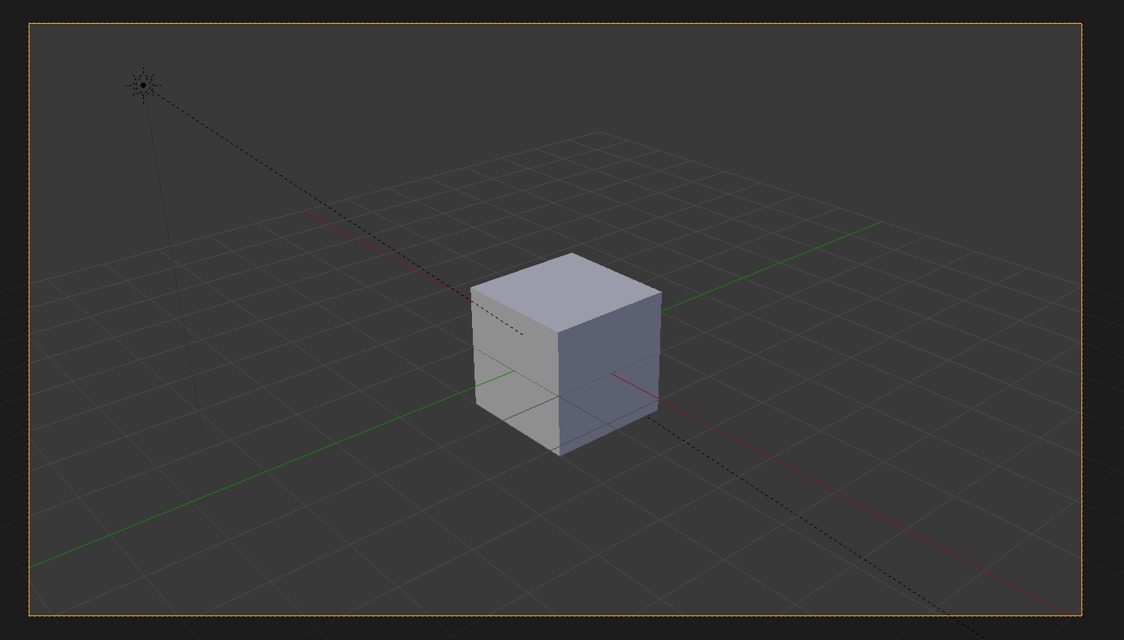
Diffuse lightning

Slide 14
Diffuse lightning - Vertexshader
[...]
// Inputs
in vec4 inputNormal;
// Outputs
out vec4 normal;
[...]
void main()
{
[...]
normal = inputNormal;
}

Slide 15
Diffuse lightning - Fragmentshader
[...]
// Inputs
in vec4 normal;
// Const inputs
uniform vec4 lightDir;
[...]
void main()
{
vec4 n = normalize(normal);
float intensity = -1 * dot(n, lightDir);
Out_Color = texture(tex0, texCoord) * intensity;
}

Slide 16
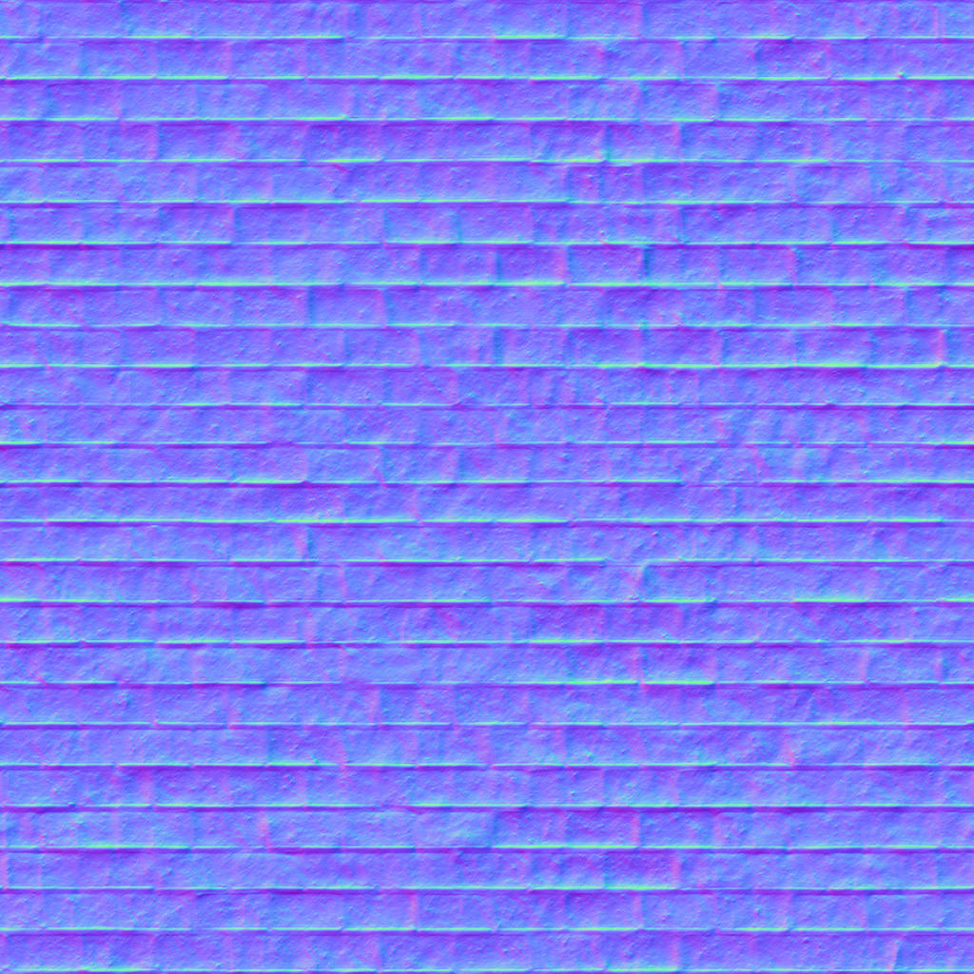
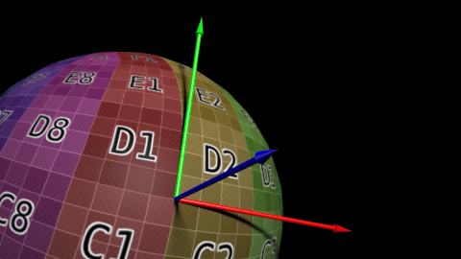
Normalmapping

Slide 17
Normalmapping - Vertexshader
[...]
// Inputs
in vec4 inputTangent;
in vec4 inputBitangent;
// Outputs
out vec4 tangent;
out vec4 bitangent;
[...]
void main()
{
[...]
tangent = inputTangent;
bitangent = inputBitangent;
}

Slide 18
Normalmapping – Fragmentshader (Header)
[...]
// Inputs
in vec4 tangent;
in vec4 bitangent;
// Const inputs
uniform sampler2D normTex;
[...]

Slide 19
Normalmapping – Fragmentshader (Body)
[...]
void main()
{
vec4 bump = texture(tex1, TexCoord.xy) * 2 – vec4(1);
vec4 n = normalize(tangent) * bump.r +
normalize(bitangent) * bump.g +
normalize(normal) * bump.b;
n = normalize(n);
[...]
}

Slide 20
Ambient lightning- Fragmentshader
[...]
void main()
{
[...]
vec4 ambient = texture(tex0, TexCoord.xy) * 0.15;
Out_Color = max(texture(tex0, texCoord) * intensity, ambient);
}

Slide 21
Specular lightning - Fragmentshader
// Const inputs
uniform vec4 camera;
uniform float materialSpecular;
uniform float materialShininess;
[...]
void main()
{
[...]
vec4 R = reflect(normLightDir, n);
float specular = max(pow(-1 * dot(R, normC), materialShininess), 0) * materialSpecular;
Out_Color = max(texture(tex0, texCoord) * intensity + specular, ambient);
}

Slide 22
Shadowmap - Vertexshader
#version 440
// Inputs
in vec4 gxl3d_Position;
// Const inputs
uniform mat4 gxl3d_ModelViewProjectionMatrix;
// Outputs
out vec4 position;
void main()
{
position = gxl3d_ModelViewProjectionMatrix * gxl3d_Position;
gl_Position = position;
}

Slide 23
Shadowmap - Fragmentshader
#version 440
// Inputs
in vec4 position;
// Outputs
out vec4 Out_Color;
void main()
{
Out_Color = vec4(position.z / 50.0);
}

Slide 24
Shadow mapping - Vertexshader
// Const inputs
uniform mat4 lightModelViewProjectionMatrix;
// Outputs
out vec4 posInLightSpace;
[...]
void main()
{
[...]
posInLightSpace = lightModelViewProjectionMatrix * gxl3d_Position;
}

Slide 25
Shadow mapping – Fragmentshader (Header)
[...]
// Inputs
in vec4 posInLightSpace;
// Const inputs
uniform sampler2D shadowMap;

Slide 26
Shadow mapping – Fragmentshader (Body)
void main()
{
float storedDistance = texture(shadowMap, posInLightSpace.xy / posInLightSpace.w / 2.0 + 0.5).x;
float realDistance = posInLightSpace.z / 50;
float visibility = 1.0;
float bias = 0.005;
if (storedDistance < realDistance - bias)
visibility = 0.4;
Out_Color = max((...) * visibility, ambient);
}

